Slide 1
Disk - Disk Golf
Scoring Elements
5
pt
1
1
2
START AREA
8
pt
5
3
6
2
5
pt
1

Slide 2
Materials needed
Standard FLL board 4’x8’
2lb coffee can – 6” diameter x 6.25” height
Foam Discs - 30 on the board
Three kleenex tissue boxes – 184 count
Electrical tape
45” 2x4 to make “barrier”
2x24-dot long in width by 2 bricks and one plate tall for “green wall”

Slide 3
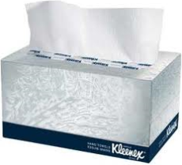
One Way To Score
Place These
The top is cut off!
The tissue boxes will be “re-arranged” at random.
Lower Multiplier
Into Here
5 pts
8 pts
5 pts

Slide 4
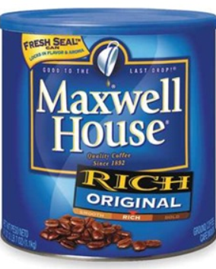
Another Way To Score
Shoot These
Shoot the disks into the can.
If they land in the blue or white zone you earn the number of points shown. The disks have to be all the way in the zone for those points. In order to shoot a disk, the robot must not be touching either zone.
5 Points
One point
Two points
2 points
1 points
One point
Zero points

Slide 5
Third Way To Score
Push These
Three points
Three points
The 2x4 barrier will have “cuts” in them to allow for pushing of the foam discs. The a disks must be completely in a zone to score for that zone; otherwise, they will score for the ‘lesser’ zone instead. This applies to the circle zones (around the coffee can) as well.
2x4 “Barrier”
3
6
1 points
Six points

Slide 6
Dimensions – Game Field
All measurements (unless otherwise noted) are measured from the table’s inside walls.
93”
4” (outer wall)
9”
36”
33”
12”
Foam disc
45”
Base
12”
0.5”
6”
27”
4”
12”
4”
16.5”
22.5”
0.5”
9”
12”
12”

Slide 7
Dimensions – Line Tracking
All measurements (unless otherwise noted) are measured from the table’s inside walls.
Measurements to electrical tape are to the center of the tape with the exception of the Base – which is 12”x12” which includes the tape.
7.5”
18”
18”
18”
7”
22.5”
6”
6”
Base
30”
16”
7.5”
15”
7.5”
7”
7.5”
36”
8”

Slide 8
Dimensions – Game Objects
Field Divider
9”
9”
9”
2x4 with the slots
4 1/4”
1”
1”
11”
8”
7”
8”
11”
1.5”
Top view of 2x4 with the slots
Rings
Dowel Rods
Inner diameter 5/8”
0.25”
1 5/8”
4”
Thickness1/8”

Slide 9
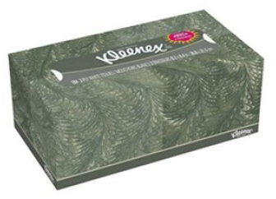
“Kleenex” Tissue box
We are going to go off of the dimensions of a standard 184 count KLEENEX brand box. I believe PUFF’s 132 count boxes are the same size.
9" long
4 3/4" wide
4 1/4" tall

Slide 10
Kleenex boxes on the “barrier”
Side view of board
Tissue Boxes
Coffee can
2x4 “Barrier”
v
At the competition, our “tissue” boxes will be made of wood, and will have an L bracket that holds them up. The boxes will be held down by dual-lock so that we can re-arrange them easily.
Notice that it is flush with the 2x4

Slide 11
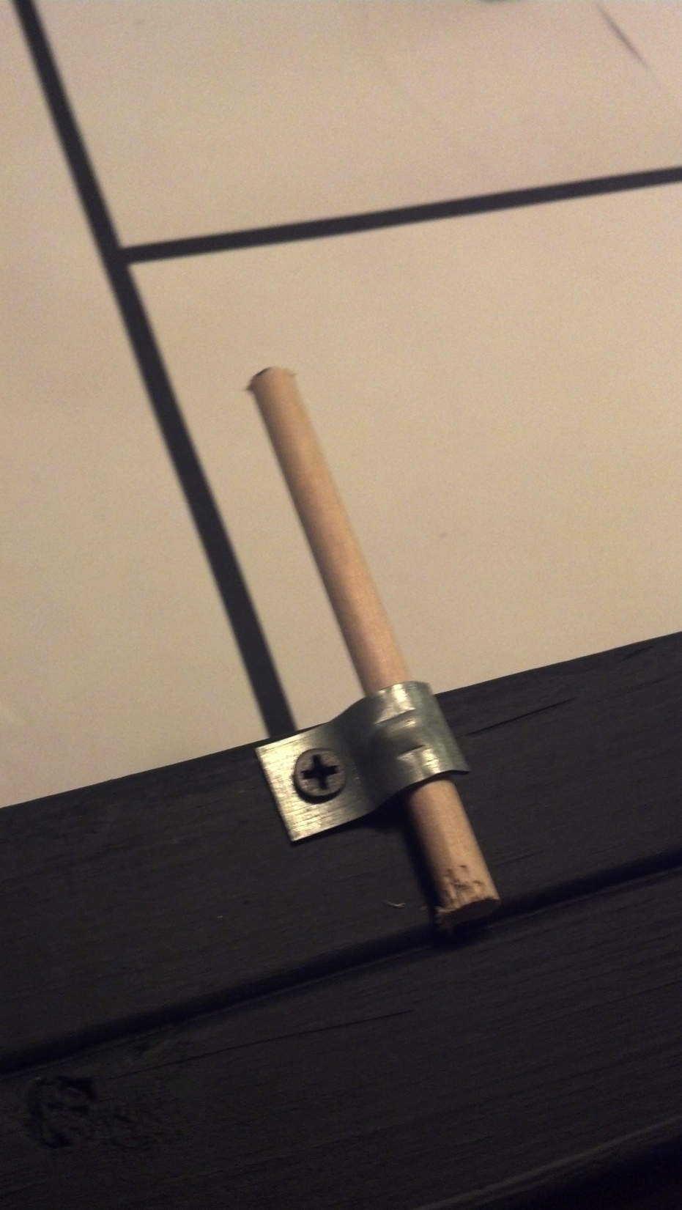
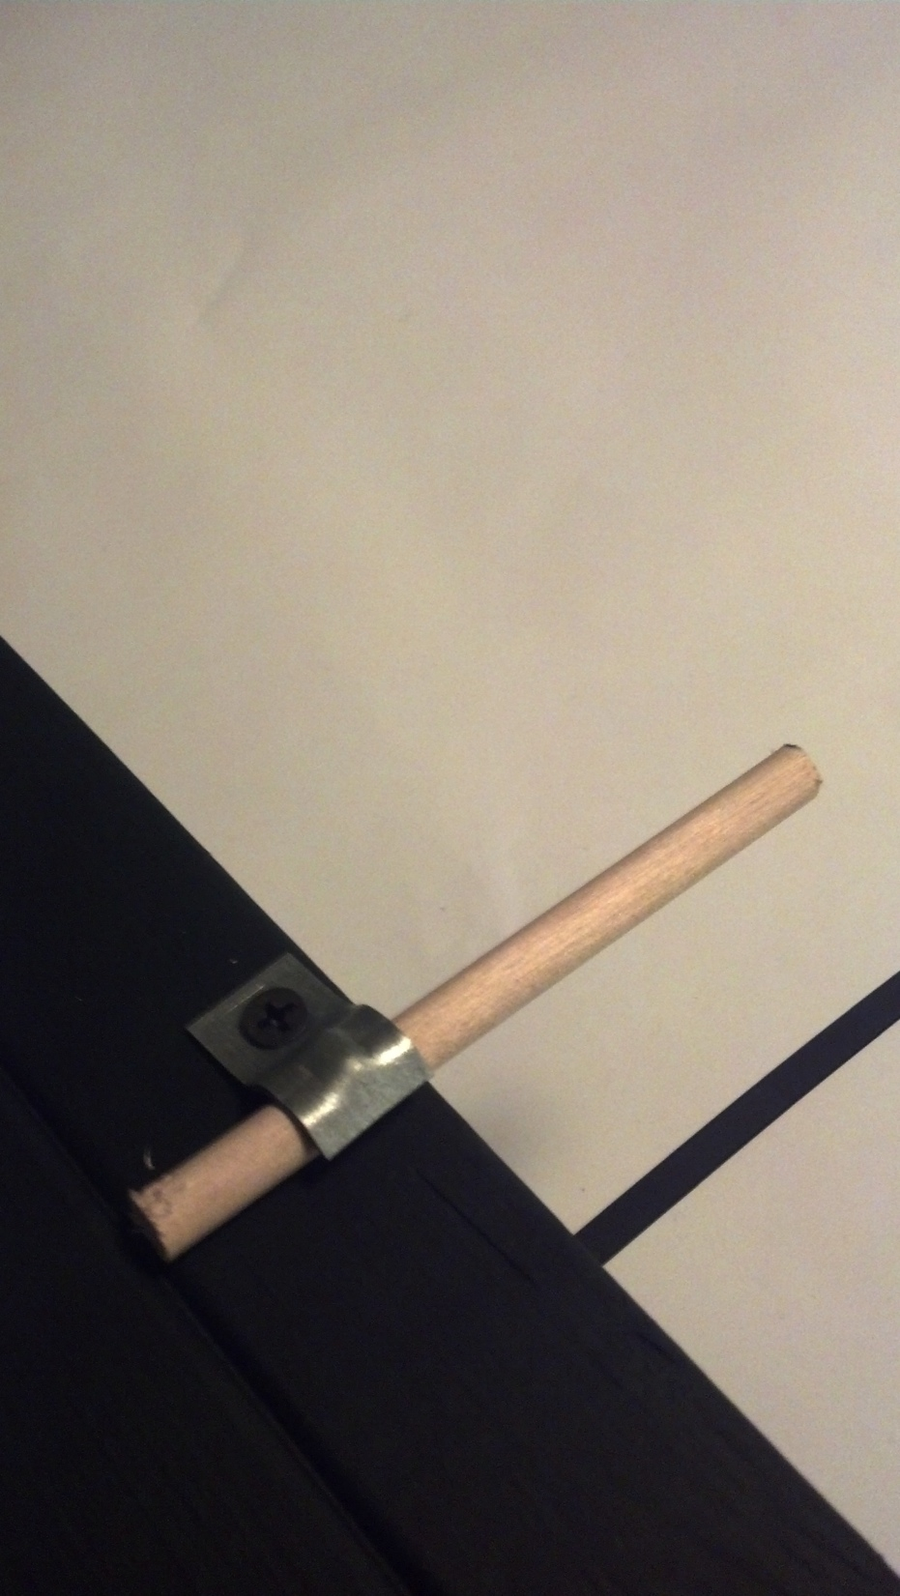
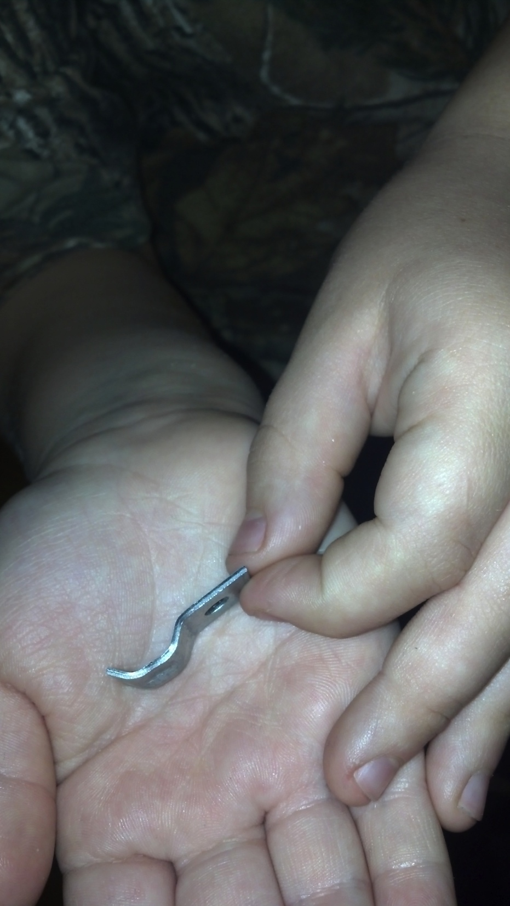
Dowel rod “holders”
The dowel rods are ¼” in diameter and 4” long. They can be held down any method you manage to get it, but one idea from Coach Anthony was using electric wire “hold downs” with drywall screws. The ones he used are for 2-12 wire, and can be found in the electrical section at Lowes or Home depot. Thanks Anthony!

Slide 12
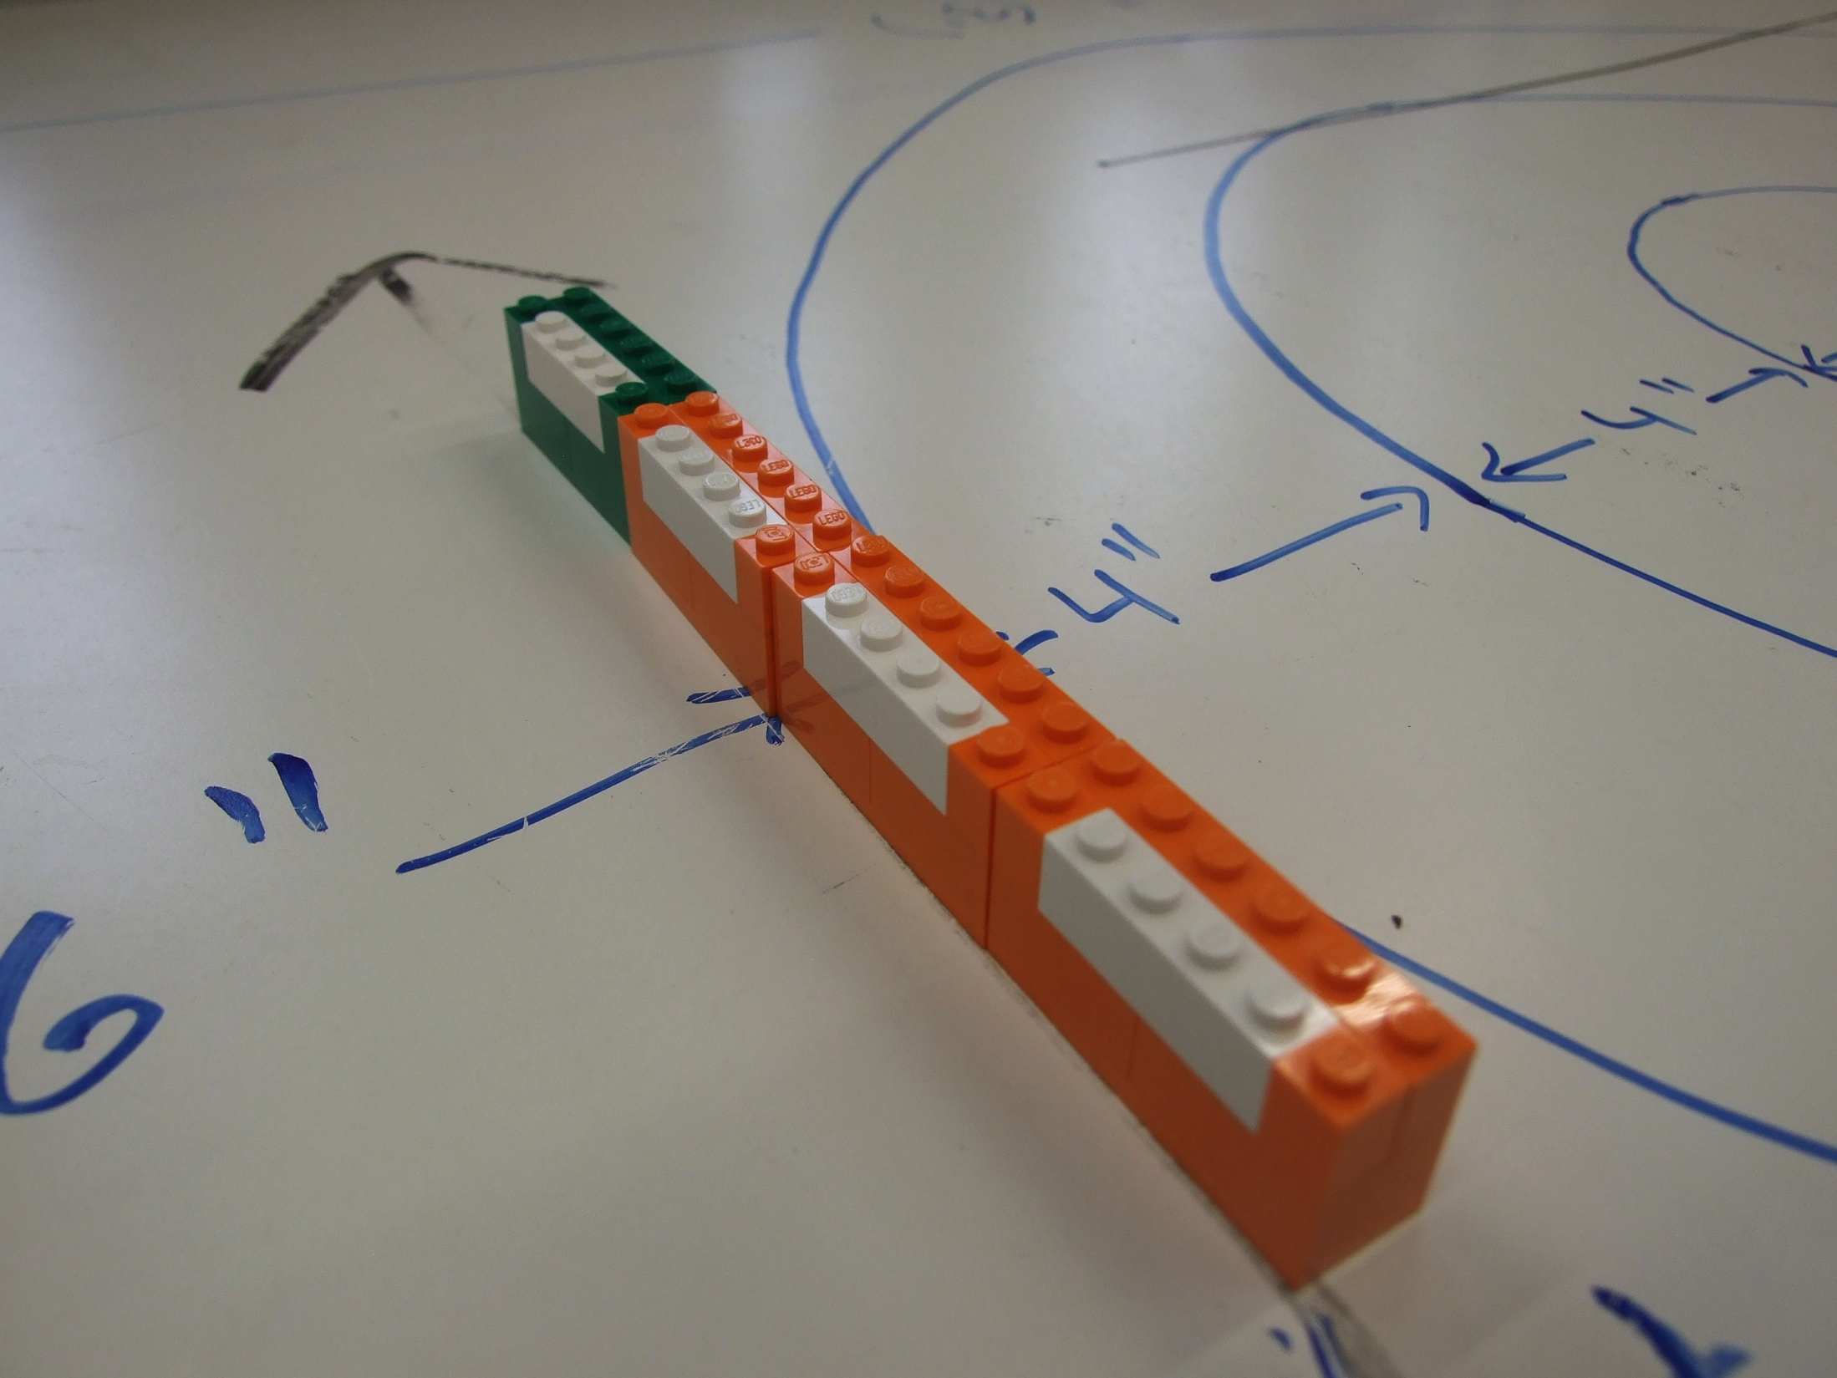
Green line
The green line is a 2-dot wide by 24-dot LEGO brick that is there to be a “wall” to prevent any pushing straight from the starting box. It is two “bricks” plus one plate in height.

Slide 13
Coffee Can
Standard 2lb coffee can (metal)
6” diameter
6.25” Height

Slide 14
Rules
2 minute 30 second rounds just like FLL.
A robot can leave its base with a maximum of 4 Rings. It can leave base with less than 4 rings, but it cannot leave with more than 4 rings.
While on the game field, there are no limits to the amount of Rings a robot can control at one time.
Any Rings that enter the base from the field are stored in the base and loaded the robot. This includes any rings that are attached to a robot when a robot is carried by a student back into base. The robot still cannot leave base with more than 4 rings, so any ‘extra’ rings will need to be stored in the base.
Any intentional manipulation of the robot to 'carry' more Rings back to base than would normally be possible will result in all Rings attached to the robot being removed from play. For instance, if robot controls a scoop that contains Rings and by picking up the robot the scoop will normally drop the Rings, the student(s) cannot manipulate the robot's scoop to prevent the Rings from dropping to the game field. This will be enforced at the referee’s discretion.
In order to load Rings onto the robot, both the robot and Rings must be fully within the base.

Slide 15
Rules
If a robot is picked up and Rings are left on the field, they cannot be carried back to the base.
If a robot is picked up and parts of the robot become detached, the students may return the parts to the base; any Rings attached to the robot’s parts must remain on the field. For instance, if robot has a scoop that contains Rings and the scoop becomes detached from the robot while on the field, the students may return the scoop to base but will have to leave the Rings on the field. The referee may move any Rings left in this way into positions matching where they would be with the robot part intact.
At any point during a match, a student may request that rings be removed from the playing field. The referee may then remove the rings at their discretion. Any Rings removed this way will not score and cannot be returned to the field.
The robot cannot score from base and must completely leave base before attempting to score. Any Rings scored from base will not count and will be removed from play.
Any single ring can only be scored in one zone. A ring must be fully inside a zone to score. A zone includes the outer edge of the tape that defines that zone (but the ring must still be fully within the tape and not touching any other zone to score).

Slide 16
Parts
Foam Rings - ~$5-6 for 24
http://www.amazon.com/Toysmith-7885-Total-X-Stream-Refill/dp/B000KA5VXQ/ref=sr_1_1?ie=UTF8&qid=1363698171&sr=8-1&keywords=foam+discs
Dowel Rods - ~$3.49 from Jo-anne
http://www.joann.com/wood-craft-dowels-1-4-x6-30-pkg/zprd_11599669a/

